Slide 1


HIGH PERFORMANCE DATA PROCESSING • PROJECT 1
Optimizing High Performance Data
Processing for Large-Scale Web Crawlers
Case Study: MyFutureJobs Job Vacancy Pipeline — Pandas vs Multiprocessing vs Polars
GROUP: SPARKLING SPARKMIND
Safiya Nursyahadah Binti Masnoor A23CS0176
Ain Nurnabila Binti Mohd Azhar A23CS0207
Farra Nurzahin Binti Zaharil Anuar A23CS0079
Dayang Farah Farzana Binti Abang Idham A23CS0071
Prepared for
Dr. Seah Choon Sen
Notes:
Greet the panel, introduce the group and the project title. Keep this brief and confident.
1

Slide 2
Introduction & Objectives
SECP3133 requires a large-scale web crawler + HPC processing pipeline at 100,000+ record scale
Background
Project Objectives
1
Crawl 100,000+ structured job vacancy records
Target: MyFutureJobs (myfuturejobs.gov.my), Malaysia's government job portal
Job vacancy data is public, well-structured, and large in volume
Pipeline built as one continuous flow: crawl → clean → optimize → evaluate
Built entirely on Google Colab with Google Drive as shared storage
2
Clean & transform into an analysis-ready dataset
3
Apply ≥ 2 HPC techniques (Multiprocessing & Polars) vs a Pandas baseline
4
Evaluate using time, memory, CPU, and throughput
5
Present findings via tables, charts & clear interpretation
Sparkling Sparkmind | SECP3133-02 High Performance Data Processing
2
Notes:
Explain the motivation: a 100,000+ record HPC pipeline, walk through the five objectives quickly, don't read every word verbatim.
2

Slide 3

Target Website & Data Fields
Fields Extracted per Listing
MyFutureJobs
Job Title
Occupation Category
Salary Range
myfuturejobs.gov.my — Government job portal
Lists vacancies across administrative, technology, manufacturing, healthcare, education, finance & more
Covers multiple Malaysian states → varied, representative dataset
Collected: 120,000+ raw records
After cleaning: 112,499 records → cleaned_data.csv
Contract Type
Working Hours
Education Level
Location
Vacancy ID
Job URL
Sparkling Sparkmind | SECP3133-02 High Performance Data Processing
3
Notes:
Introduce MyFutureJobs as the chosen site and why it fit the requirement. Point out the 9 extracted fields briefly.
3

Slide 4



System Design & Architecture
A three-stage pipeline running end-to-end on Google Colab, with Google Drive as shared storage
1. Collection
2. Cleaning
3. Optimize & Evaluate
Crawl sector pages, extract fields, save JSON progressively to Drive
→
Parse titles/IDs & salary text, drop duplicates & incomplete rows, export CSV
→
Run Pandas / Multiprocessing / Polars on identical data, measure metrics
Requests, BeautifulSoup
Pandas, JSON, CSV
Joblib, Polars, psutil
Dataset scale (~112K rows) did not justify heavier frameworks like Spark — a decision later supported by the results.
Sparkling Sparkmind | SECP3133-02 High Performance Data Processing
4
Notes:
Walk through the 3-stage architecture left to right. Mention why Spark wasn't necessary at this scale.
4

Slide 5
Data Collection
120,000+
Crawling Method
raw records crawled
Requests + BeautifulSoup, with a browser-like User-Agent to reduce blocking
Sector-by-sector crawl across MyFutureJobs categories for variety across industries & states
Each listing appended and saved progressively to JSON — no data lost on interruption
Ethics: only public listings, no login-protected content, no personal applicant data collected
112,499
cleaned records retained
2–4s
randomized crawl delay
Sparkling Sparkmind | SECP3133-02 High Performance Data Processing
5
Notes:
Describe how the crawler worked ethically and reliably: delay, progressive saving, and the final record counts.
5

Slide 6
Data Processing: The Cleaning Pipeline
raw_data.json → five-step cleaning pipeline → cleaned_data.csv (used identically by all 3 approaches)
1
2
3
4
5
Extract titles & IDs
Parse salary text
Remove duplicates
Handle missing values
Export dataset
Regex splits combined “Title (Ref: #ID)” text into job_title and vacancy_id
“RM 2530 - RM 3946” → salary_min, salary_max, salary_average
drop_duplicates() on vacancy_id, keeping first occurrence
Standardize “N/A” to NaN; drop unused employer_name column
Final DataFrame written to cleaned_data.csv as the shared benchmark input
Sparkling Sparkmind | SECP3133-02 High Performance Data Processing
6
Notes:
Summarize the 5-step cleaning pipeline that produces the single shared cleaned_data.csv used by every method.
6

Slide 7



Optimization Techniques Compared
Same workflow (filter → feature engineering → group-by aggregation) run three different ways
Pandas (Baseline)
Multiprocessing
Polars
Standard single-threaded pandas: pd.read_csv → boolean-mask filter → groupby().agg(). Ceiling set by single-core speed.
Joblib (loky backend) splits the DataFrame into chunks across worker processes to bypass Python's GIL. Worker logic externalized to a standalone module to fix a Windows/Colab notebook recursion bug.
Rust-based, lazy-evaluated engine. pl.scan_csv() builds a query plan; .collect() optimizes and auto-parallelizes across cores using Apache Arrow's columnar format.
Reference point
GIL workaround
Best performer
Sparkling Sparkmind | SECP3133-02 High Performance Data Processing
7
Notes:
Introduce each of the 3 processing approaches at a high level before jumping into results.
7

Slide 8
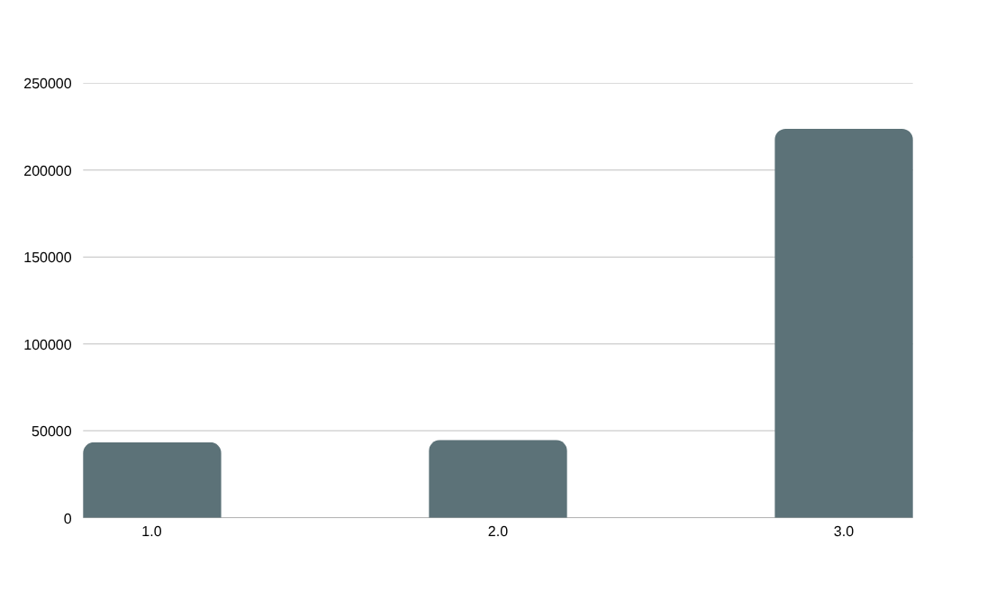
Performance Evaluation: The Results
Averaged over five independent trials on the cleaned dataset (Table 1)
Metric | Pandas | Multiprocessing | Polars
Avg Time (s) | 0.160 | 0.162 | 0.031
Avg Memory (MB) | 3.931 | 6.581 | 0.193
Avg CPU (%) | 91.220 | 47.407 | 25.780
Polars: 5.16× faster and 20.4× more memory-efficient than Pandas, using less CPU while doing more work.
Multiprocessing: only 1.25% faster than baseline — process overhead (packing/copying chunks) outweighs the parallelization benefit at this scale.
Sparkling Sparkmind | SECP3133-02 High Performance Data Processing
8
Notes:
Walk through the throughput chart and the metrics table. Emphasize the big number: Polars' 223,652 jobs/sec.
8

Slide 9



Detailed Findings & Interpretation
Execution Speed
Memory Efficiency
Polars: 0.031s (5.16× faster). Multiprocessing overhead outweighs parallel benefit at ~112K rows — hardware parallelism only pays off at much larger scale.
Polars uses 20.4× less memory via lazy evaluation (filters before materializing). Multiprocessing uses more than Pandas — 16 workers replicate data across separate memory spaces.
CPU Utilization
Throughput
Pandas hits 91.2% CPU (compute-bound). Polars needs only 25.8% CPU to do more work — algorithmic optimization beats raw processor power.
Polars: 223,653 jobs/s vs Pandas' 43,395 and Multiprocessing's 44,723 — confirming minimal benefit from parallel workers at this dataset scale.
Sparkling Sparkmind | SECP3133-02 High Performance Data Processing
9
Notes:
Explain WHY Polars wins: lazy evaluation, Arrow columnar format, internal parallelism vs multiprocessing overhead.
9

Slide 10



Challenges & Limitations
Multiprocessing broke in Jupyter on Windows
Multiprocessing was slower than baseline
CPU measurement was unreliable
Windows re-imports the parent script for each worker — caused infinite recursion. Fixed by moving the worker function into a standalone job_mp_worker.py module.
Only 2 CPU cores available on Colab; splitting/copying chunks between processes cost more than the 2-core speed-up on this lightweight task (used ~104MB vs 62.5MB memory).
psutil measures whole-machine usage, not per-worker; Colab's shared CPU caused inconsistent readings run to run (e.g. Pandas: 95–96% → 55–64% across trials).
Sparkling Sparkmind | SECP3133-02 High Performance Data Processing
10
Notes:
Be transparent about real problems faced: the Windows recursion bug, multiprocessing underperforming, and CPU measurement noise.
10

Slide 11

Conclusion & Future Work
Final Comparison (Table 7.2, 5-run average)
Future Work
Method | Time (s) | Memory (MB) | CPU % | Throughput (rows/s)
Pandas (Baseline) | 1.327 | 62.5 | 81.4 | 87,734
Multiprocessing | 1.697 | 104.4 | 59.0 | 66,313
Polars | 0.326 | 10.7 | 89.6 | 345,663
Test with more CPU cores (4–8+) to give multiprocessing a fairer chance
Benchmark a heavier per-row computation to reveal parallelism benefits
Add async/threaded crawling to speed up the collection stage itself
Measure CPU per worker process on a dedicated, non-shared machine
Polars wins: ~4× faster than Pandas, ~5× faster than multiprocessing, using far less memory — lazy evaluation + internal parallelization beats manual process-splitting.
Sparkling Sparkmind | SECP3133-02 High Performance Data Processing
11
Notes:
Recap the final table and give 2-3 concrete next steps for future iterations.
11

Slide 12

Thank You
Questions & Discussion
Group Sparkling Sparkmind • SECP3133-02 High Performance Data Processing
Notes:
Thank the audience and invite questions.
12

